Slide 1
Software Engineering and Architecture
Some General Observations on the Mandatory

Slide 2
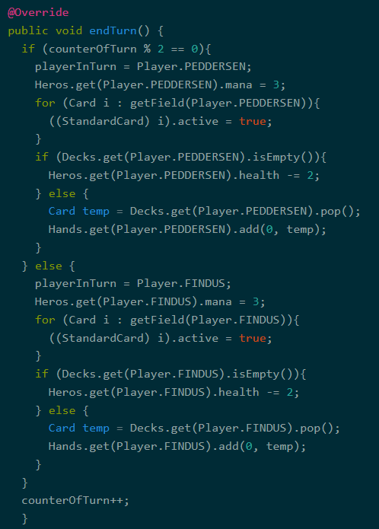
From the Trenches…
Code duplication is…
… a place where you clean code

Slide 3
“Inner” and “Outer”
Encapsulation: Who can do what?

Slide 4
How do I?
Switch from channel TV2 to DR on my Samsung TV set?
A) Push the Button ‘3’ on the TV’s remote control interface?
B) Call Samsung to tell them to send a man to re-solder the wire inside the TV set?
Some of you accidentally use method B

Slide 5
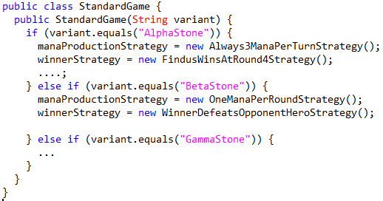
Example
What happens when I want a SigmaStone variant?
I have to call you guys to resolder the wires inside!

Slide 6
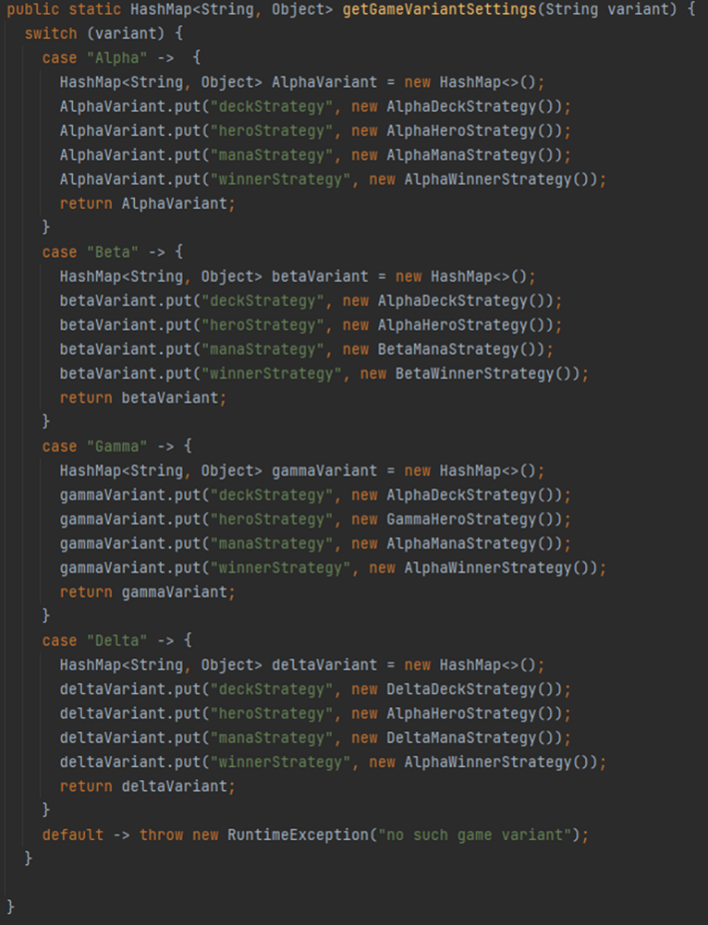
From the Trenches
Or – your own code…

Slide 7
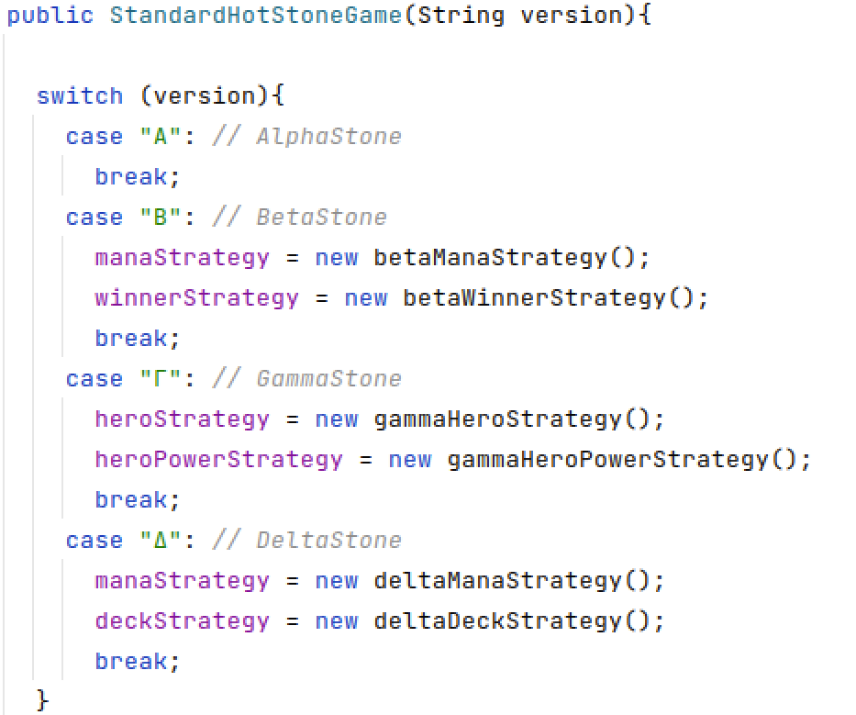
From the Trenches
Or…

Slide 8
Frameworks
What is the process in the mandatory exercises?
To use TDD and compositional design to transform an AlphaStone application into a HotStone framework
Frameworks are
Reusable software designs and implementations
Must be reconfigurable from the outside
Just like a TV set
Example
Android Google’s smartphone OS
You do not call Google to make them rewrite their constructor in order to introduce the App for your HCI course, do you!?!

Slide 9
Open/Closed
Open for Extension (I can adapt the framework)
Closed for Modification (But I cannot rewrite the code)
Change by addition, not by modification
So
… is not suitable for implementing frameworks…
I have to open the TV to solder the wires inside ☹
You have to call Google to make your HCI project app ☹

Slide 10
So…
Keep StandardGame, (StandardHero, StandardCard), … closed for modification! General enough to handle many variants
They form the framework that is reused as-is
Allow adapting HotStone to a new variant by addition
I can code a new DeckBuildingStrategy which allows users to load a deck that they have crafted in a deck editor…
I can code a PriestHero which can heal minions on field…
And provide my strategies in the constructor of your StdGame
And it will do the right thing…

Slide 11
Uncle Bob???
What about Uncle Bob?
Though shall not have more than two parameters as arguments
Disobey him for now…
GameImpl(WinnerStrategy winnerStrategy, …………………..)
We will refactor HotStone soon to fix it…
Abstract Factory…

Slide 12
You Can Do More Outside
Inner and Outer have different Rules!

Slide 13
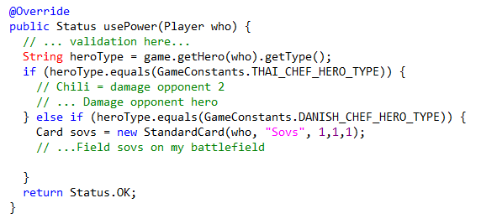
Parametric Variant
Example:
GammaStone requirement: Heroes do different things
HotStone Framework Code
Coded by switching within StandardGame
Notes:
Meta: Code in codelab/W5-xx.java

Slide 14
Parametric Variant
Example:
GammaStone requirement: Heroes do different things
HotStone Framework Code
Liability: HotStone has hard bindings to specific Hero types. Only Change by Modification!

Slide 15
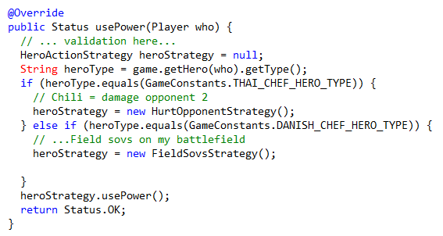
The Worst of All Worlds design
Example:
GammaStone requirement: Heroes do different things
GammaStone Delegates
HeroActionStrategy
Notes:
Consider that unit switching code is still present in some form in GameImpl

Slide 16
The Worst of All Worlds design
Example:
GammaStone requirement: Heroes do different things
REALLY BAD: If you have hero-type switching code in GameImpl, you still have a parametric solution with all its liabilities!!!
Plus all the extra interfaces of the compositional approach.
DO THE SAME THING
THE SAME WAY!!!
GammaStone Delegates
HeroActionStrategy
Notes:
Consider that unit switching code is still present in some form in GameImpl

Slide 17
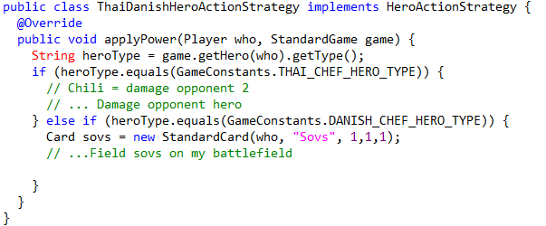
Compositional Variant
Example:
GammaStone requirement: Heroes do different things
HotStone Framework Code:
GammaStone Delegates
ThaiDanishHeroStrategy
Notes:
Consider unit type switching code is present in the UnitActionStrategy

Slide 18
Compositional Variant
Example:
GammaStone requirement: Heroes do different things
HotStone Framework Code:
GammaStone Delegates
What would Henrik say? Is this Parametric design???
ThaiDanishHeroStrategy
Notes:
Consider unit type switching code is present in the UnitActionStrategy

Slide 19
Compositional Variant
Example:
GammaStone requirement: Heroes do different things
This is a much better design! Why? Because a) No hard binding in Game b) GammaStone requirements are expressed explicitly in a single piece of code that bears the correct name!
HotStone Framework Code:
GammaStone Delegates
ThaiDanishHeroStrategy
Notes:
Consider unit type switching code is present in the UnitActionStrategy

Slide 20
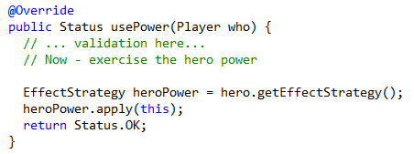
Compositional Variant
And you can avoid the switching completely
Put the ‘power strategy’ into the Hero implementation instead; fetch it, and then apply it…
Requires a ‘HeroBuildingStrategy’ to create the proper Hero types, then…
Critique: Approaching is a way to implement subclassing by hand ☺…

Slide 21
Inner and Outer
Keep inner code (framework code) clean of variability switching code; have it in the outer code (delegates)!
Delegates
HotStone Framework Code:
General Game implementation, general Hero and Card implementations
….
HeroAction
WinnerDetermination
WinnerDetermination
Closed for Modification
Open for Extension

Slide 22
Clean Code: Prefer Exceptions

Slide 23
Uncle Bob
Prefer exceptions over returning status codes
Throw PageDoesNotExistException instead of return E_PAGE_DOES_NOT_EXIST
So why have you decided on the Status enum???
Argument
Hm hm hm… None!
Conclusion: On the ToDo list for next year
But keep it as the GUI will assume it!

